Slide 1


Slide 2
Wireless Networking, Eduroam & Easy Deployment
By Gareth Ayres

Slide 3
Agenda
1.0 Where we have been
2.0 Where we are now
3.0 What's changed?
4.0 Why?!?!
5.0 Where are we heading?

Slide 4

1.1 Where we have been: 2004
2004-2005
4 RoamNode Servers (VPN & PPPOE)
250 Autonomous access points
~800 unique users / day

Slide 5
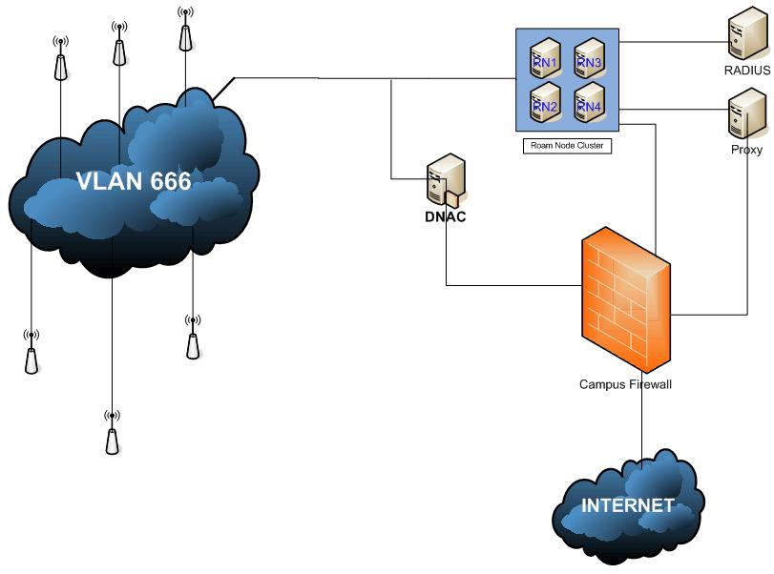
1.1 Where we have been: 2004

Slide 6
1.1 Where we have been: 2004

Slide 7

1.2 Where we have been: 2007
2007-2008
10 RoamNode Servers (VPN servers)
700 Autonomous access points
Setup Wireless Network
~2300 unique users / day

Slide 8
1.2 Where we have been: 2007

Slide 9
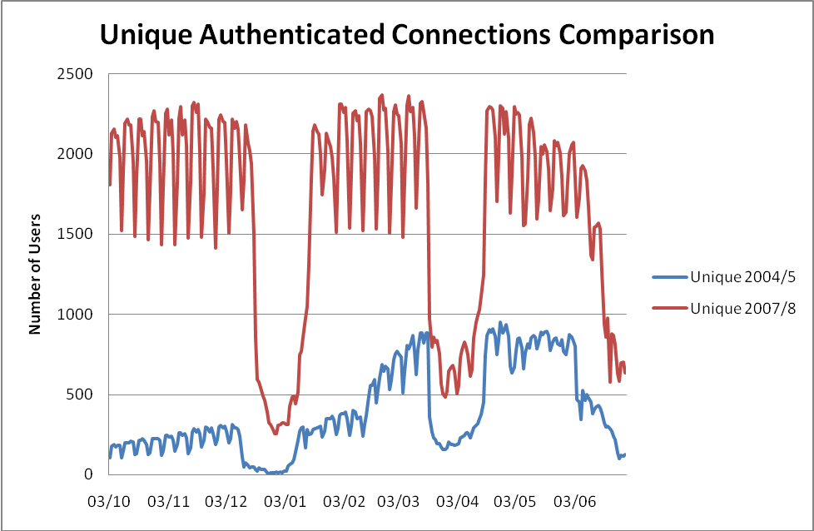
1.2 Where we have been: 2007

Slide 10
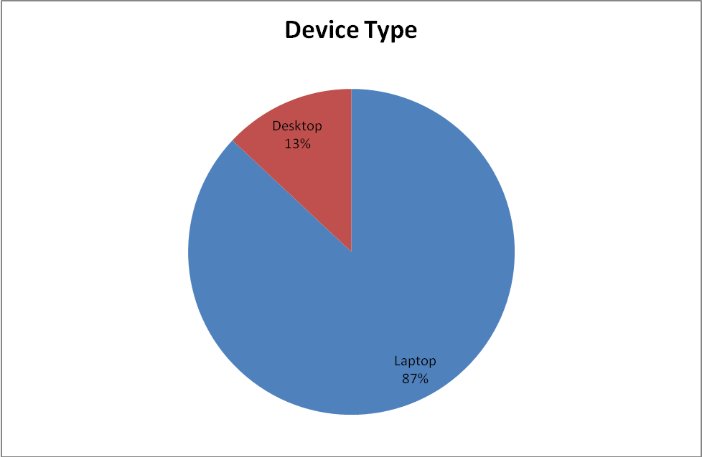
1.2 Where we have been: 2007

Slide 11
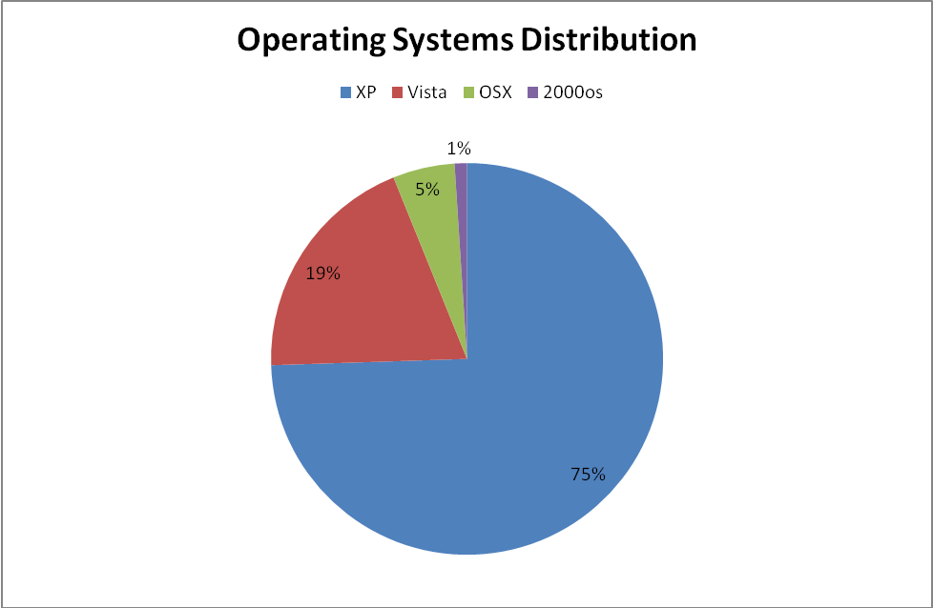
1.2 Where we have been: 2007

Slide 12

2.0 Where we are now
2009-2010
0 RoamNode Servers
~850 Lightweight access points
4 Cisco WiSM’s
~3000 unique users / day

Slide 13
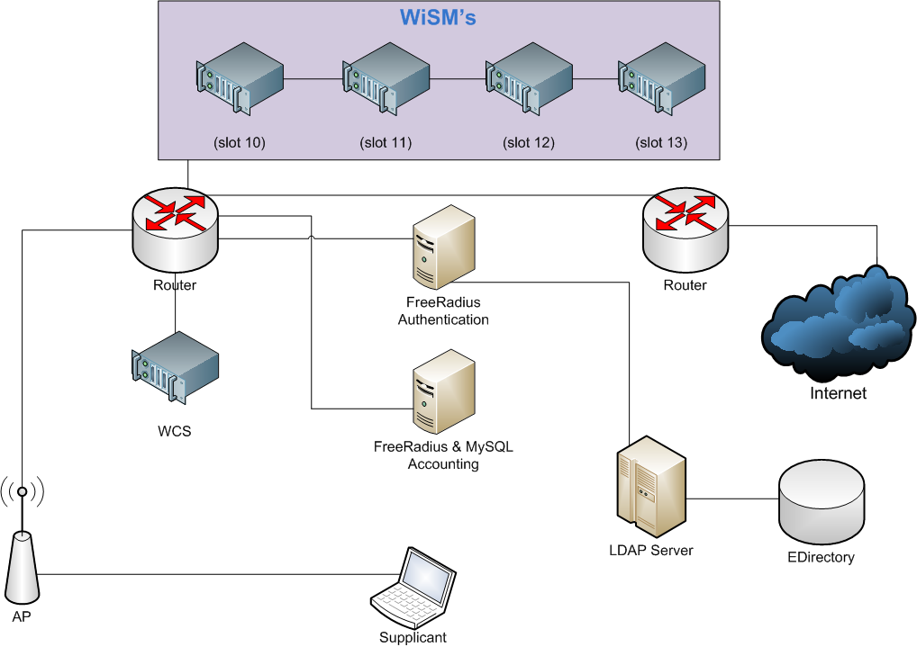
2.0 Where we are now: 2009

Slide 14
2.0 Where we are now: 2010

Slide 15
2.0 Where we are now

Slide 16
2.0 Where we are now: 2009

Slide 17
2.0 Where we are now: 2009

Slide 18
3.0 What's changed
2005 – 2008
    Wireless for the geeks
    Laptops and the odd PDA
    Web (BBC News) & MSN = Happy Users
    Users put up with disconnections
    Wireless is fallback for wire

Slide 19
3.0 What's changed
2009 – 2010
    Wireless for everyone
    Every device is wireless enabled
      (Laptop, phone, desktops, games consoles)
    Web (Facebook!), VoIP, IPTV, Streaming (iPlayer), Gaming, E-Learning.....
    Users unhappy with ANY interruption of Lost episode
    Wireless is some users ONLY access method

Slide 20

4.0 Why?!?!
  Cheaper?
  Faster?
  Stronger?
Doesn't matter why, we will have to deal with it.

Slide 21
5.0 Where are we heading?
Better wireless infrastructure
Easier deployment and configuration
Gaming over wireless
The Janet Roaming Service

Slide 22
5.1 Where are we heading?
Better wireless infrastructure:
802.11n
    Faster (Up to 300Mbs)
    Further
    But more power demanding
    Need 1Gb everywhere

Slide 23

5.2 Where are we heading?
Easier deployment and configuration:
SU1X – Windows setup tool
    Automatically configures XP, Vista, 7
    Installs certs and provides help
    Deployed from setup SSID during registration
    http://su1x.sourceforge.net/
    By Swansea University (Janet UK funded)
    Open Source

Slide 24
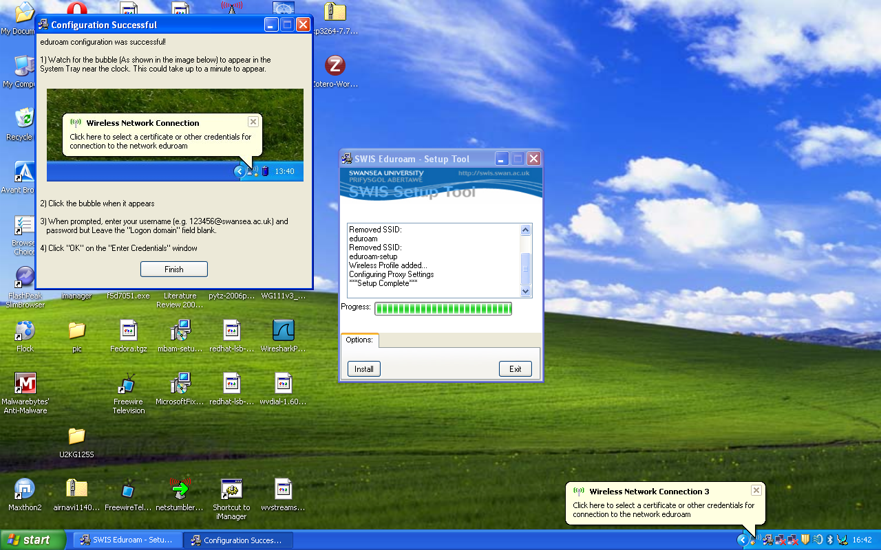
SU1X - Setup Tool

Slide 25
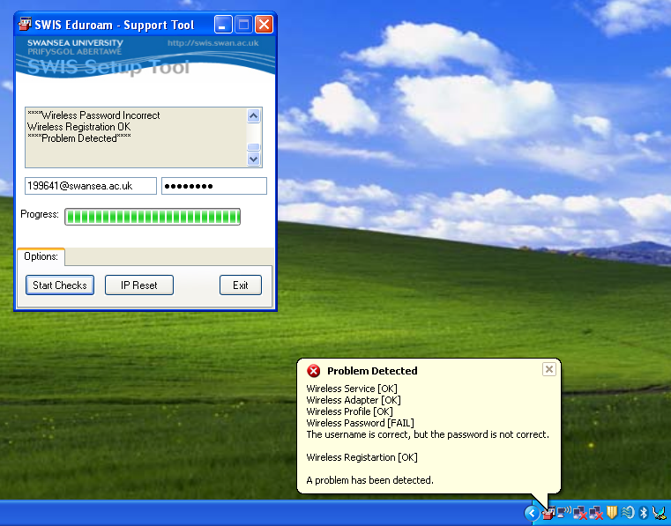
SU1X - Support Tool

Slide 26
5.3 Where are we heading?
Gaming over wireless:
  Biggest complaint of users, cant use XBOX
  XBOX/PS3/Wii/PSP/DS dont support WPA-Enterprise
  WPA-PSK network for games consoles
  Separate SSID “swis-gaming”
  MAC/DHCP security

Slide 27
5.4 Where are we heading?
Janet Roaming Service:
  SSID = Eduroam
  Home Users
  Visiting Users
  Why?
  All Swansea users can user wireless all around the world

Slide 28
Thank You – Any Questions?
Gareth Ayres
g.j.ayres@swansea.ac.uk

